Slide 1
Azure Management Tool
Power Shell & Cloud Shell
Presentation from 박 찬
Mail Address : chan157@naver.com
GitHub : https://github.com/chan157/TIL/
Phone Number : 010-4484-1251

Slide 2
Azure Management Tool
Power Shell & Cloud Shell
Basic Concept
01
Basic Concept
01
Basic Concept
01
Power Shell
02
Cloud Shell
03
Question
04

Slide 3
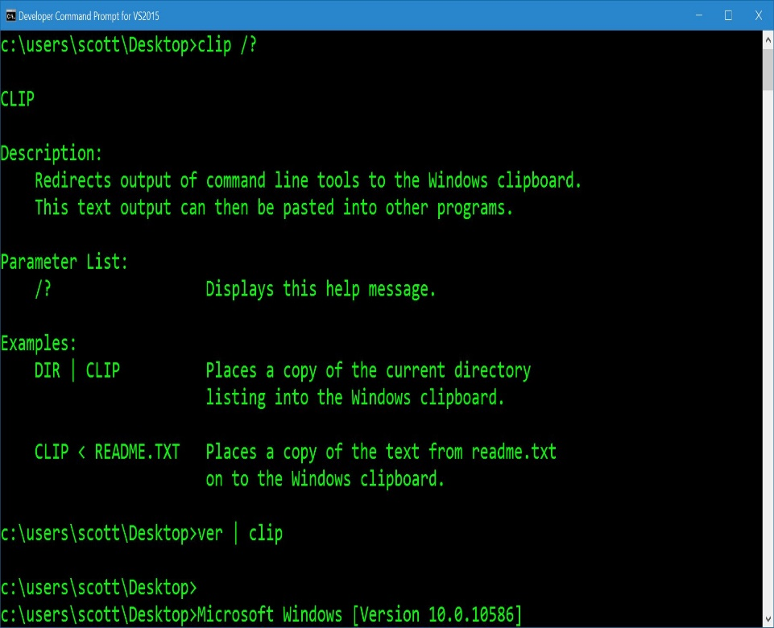
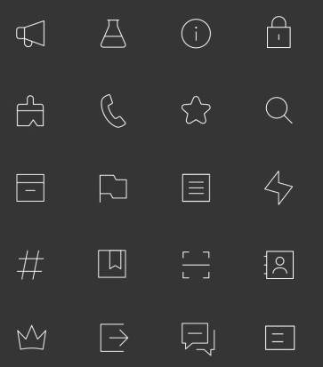
Azure Management Tool Power Shell & Cloud Shell
Basic Concept. 01
Azure Management Tool
GUI
CODE
Notes:
일반 Windows에는 Azure를 제어할 수 있는 Azure Module이 내장되어 있지 않으므로 Module 다운로드가 필요합니다.

Slide 4
Azure Management Tool Power Shell & Cloud Shell
Basic Concept. 01
Azure Management Tool
Power Shell
Only Windows
PowerShell ISE : 명령어 스크립트화
Command Prompt 에서 사용가능
명령어가 길고 복잡함
Azure CLI
Windows, Linux, Mac 등 모든 OS 지원
명령어가 짧고 단순함
Cloud Shell
Azure Portal 에서 Power Shell과 Azure CLI 모두 사용 가능
Notes:
일반 Windows에는 Azure를 제어할 수 있는 Azure Module이 내장되어 있지 않으므로 Module 다운로드가 필요합니다.

Slide 5
Azure Management Tool
Power Shell & Cloud Shell
Basic Concept
01
Power Shell
02
Power Shell
02
Power Shell
02
Cloud Shell
03
Question
04

Slide 6
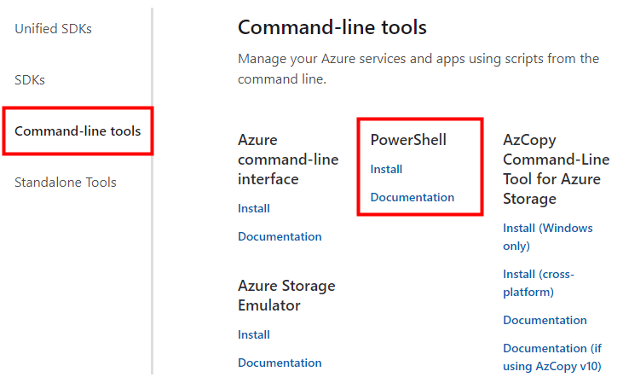
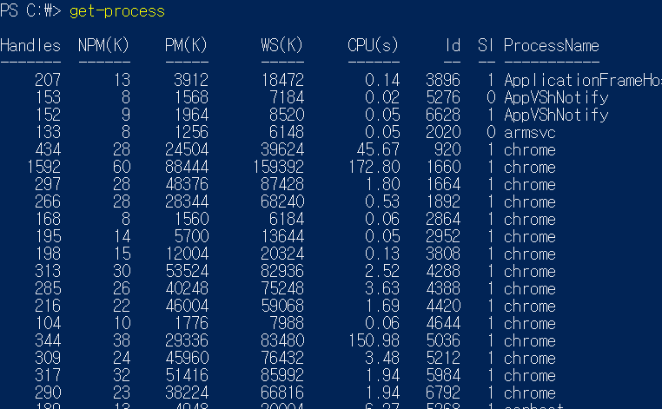
Azure Management Tool Power Shell & Cloud Shell
Power Shell. 02
Power Shell 환경 구축
https://azure.microsoft.com/en-us/downloads/
Power Shell Turn On
get-command
get-process
Notes:
일반 Windows에는 Azure를 제어할 수 있는 Azure Module이 내장되어 있지 않으므로 Module 다운로드가 필요합니다.

Slide 7
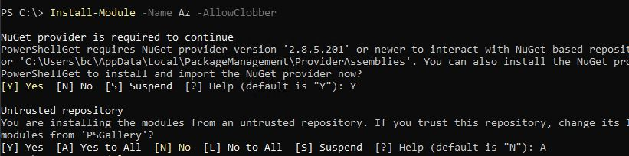
Azure Management Tool Power Shell & Cloud Shell
Power Shell. 02
3. Azure PowerShell Module 설치
Install-Module –Name Az –AllowClobber
Yes All

Slide 8
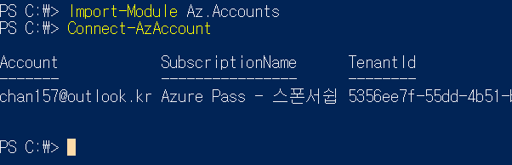
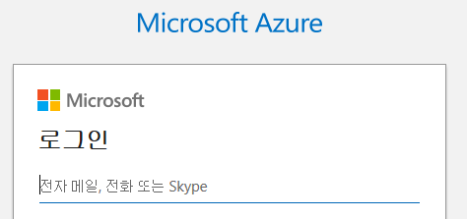
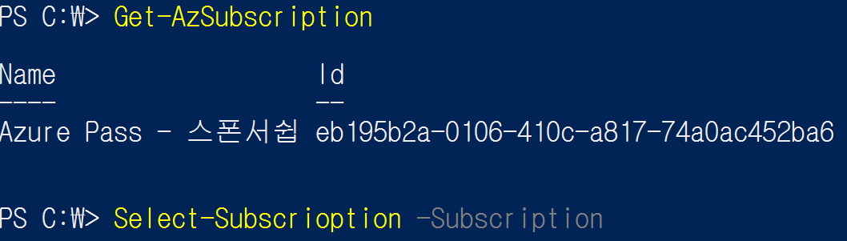
Azure Management Tool Power Shell & Cloud Shell
Power Shell. 02
4. PowerShell을 통해 Azure 접속
Notes:
## Import Azure Module
Import-Module Az.Accounts
## Azure Account Connet
Connect-AzAccount
## Sign in Azure
## Subscription ID가 여러개인 경우
Get-AzSubscription ##Subscription Checking
Select-AzSubscription -Subscription <Subscription ID> ## Subscription Sellecting
# Resource Group 만들기
New-AzResourceGroup -Name myResourceGroup -Location EastUS
# New VM 만들기 # `(빽틱) 은 다음 줄로 연결되도록 하는 것
New-AzVm `
-ResourceGroupName "myResourceGroup" `
-Name "myVM" `
-Location "East US" `
-VirtualNetworkName "myVnet" `
-SubnetName "mySubnet" `
-SecurityGroupName "myNetworkSecurityGroup" `
-PublicIpAddressName "myPublicIpAddress" `
-OpenPorts 80,3389
# IpAddress Checking
Get-AzPublicIpAddress -ResourceGroupName "myResourceGroup" | Select "IpAddress"

Slide 9
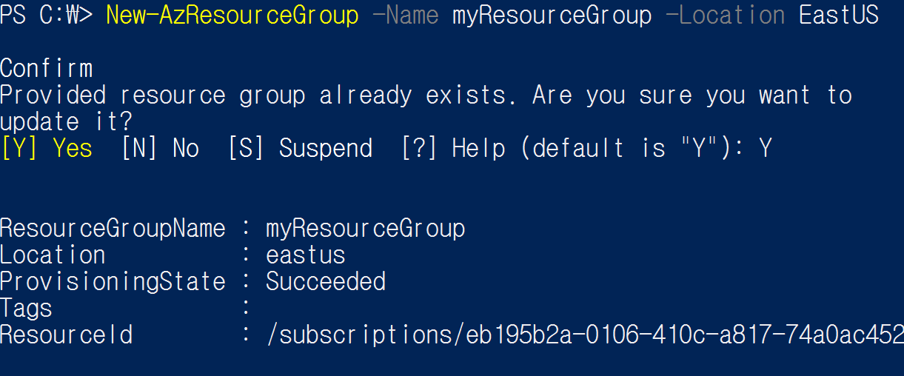
Azure Management Tool Power Shell & Cloud Shell
Power Shell. 02
5. Resource Group 생성
Notes:
## Import Azure Module
Import-Module Az.Accounts
## Azure Account Connet
Connect-AzAccount
## Sign in Azure
## Subscription ID가 여러개인 경우
Get-AzSubscription ##Subscription Checking
Select-AzSubscription -Subscription <Subscription ID> ## Subscription Sellecting
# Resource Group 만들기
New-AzResourceGroup -Name myResourceGroup -Location EastUS
# New VM 만들기 # `(빽틱) 은 다음 줄로 연결되도록 하는 것
New-AzVm `
-ResourceGroupName "myResourceGroup" `
-Name "myVM" `
-Location "East US" `
-VirtualNetworkName "myVnet" `
-SubnetName "mySubnet" `
-SecurityGroupName "myNetworkSecurityGroup" `
-PublicIpAddressName "myPublicIpAddress" `
-OpenPorts 80,3389
# IpAddress Checking
Get-AzPublicIpAddress -ResourceGroupName "myResourceGroup" | Select "IpAddress"
# VM 접속
mstsc /v 13.92.228.37
# Resource Group 생성할 때 만든 계정으로 로그인
# Webserver install
Install-WindowsFeature -name Web-Server -IncludeManagementTools
# Remove Resource 리소스가 더이상 필요 없을때 제거
Remove-AzResourceGroup -Name myResourceGroup

Slide 10
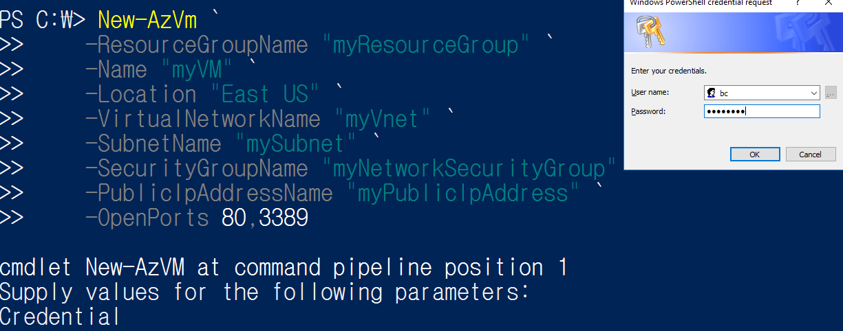
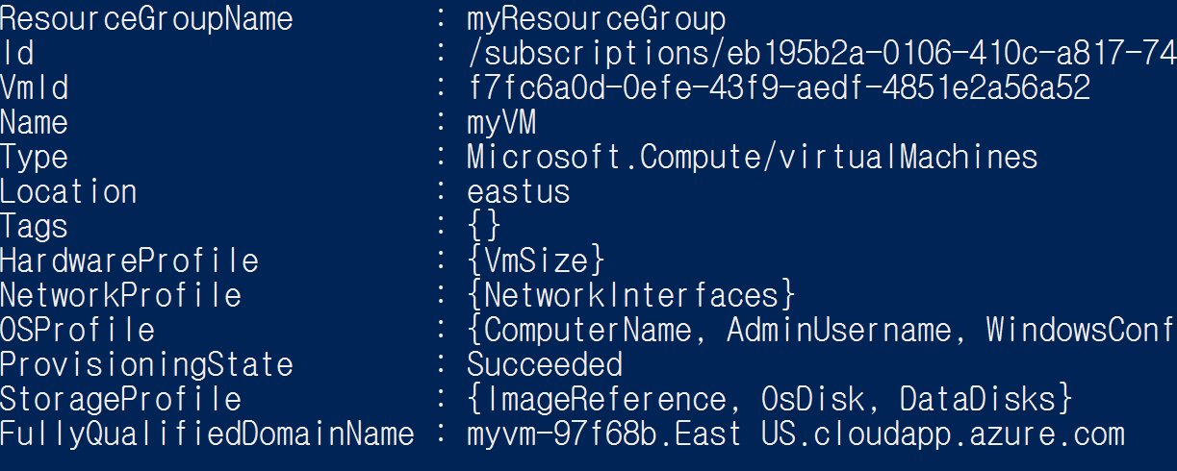
Azure Management Tool Power Shell & Cloud Shell
Power Shell. 02
6. 가상 머신 만들기
Notes:
## Import Azure Module
Import-Module Az.Accounts
## Azure Account Connet
Connect-AzAccount
## Sign in Azure
## Subscription ID가 여러개인 경우
Get-AzSubscription ##Subscription Checking
Select-AzSubscription -Subscription <Subscription ID> ## Subscription Sellecting
# Resource Group 만들기
New-AzResourceGroup -Name myResourceGroup -Location EastUS
# New VM 만들기 # `(빽틱) 은 다음 줄로 연결되도록 하는 것
New-AzVm `
-ResourceGroupName "myResourceGroup" `
-Name "myVM" `
-Location "East US" `
-VirtualNetworkName "myVnet" `
-SubnetName "mySubnet" `
-SecurityGroupName "myNetworkSecurityGroup" `
-PublicIpAddressName "myPublicIpAddress" `
-OpenPorts 80,3389
# IpAddress Checking
Get-AzPublicIpAddress -ResourceGroupName "myResourceGroup" | Select "IpAddress"
# VM 접속
mstsc /v 13.92.228.37
# Resource Group 생성할 때 만든 계정으로 로그인
# Webserver install
Install-WindowsFeature -name Web-Server -IncludeManagementTools
# Remove Resource 리소스가 더이상 필요 없을때 제거
Remove-AzResourceGroup -Name myResourceGroup

Slide 11
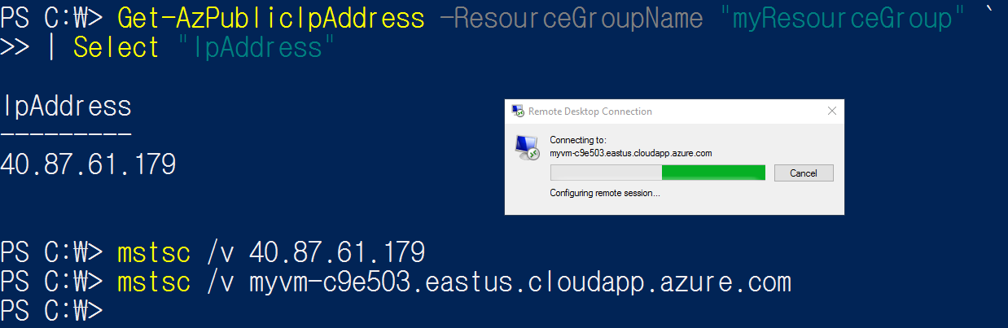
Azure Management Tool Power Shell & Cloud Shell
Power Shell. 02
7. 가상 머신 연결 및 원격접속
Notes:
## Import Azure Module
Import-Module Az.Accounts
## Azure Account Connet
Connect-AzAccount
## Sign in Azure
## Subscription ID가 여러개인 경우
Get-AzSubscription ##Subscription Checking
Select-AzSubscription -Subscription <Subscription ID> ## Subscription Sellecting
# Resource Group 만들기
New-AzResourceGroup -Name myResourceGroup -Location EastUS
# New VM 만들기 # `(빽틱) 은 다음 줄로 연결되도록 하는 것
New-AzVm `
-ResourceGroupName "myResourceGroup" `
-Name "myVM" `
-Location "East US" `
-VirtualNetworkName "myVnet" `
-SubnetName "mySubnet" `
-SecurityGroupName "myNetworkSecurityGroup" `
-PublicIpAddressName "myPublicIpAddress" `
-OpenPorts 80,3389
# IpAddress Checking
Get-AzPublicIpAddress -ResourceGroupName "myResourceGroup" | Select "IpAddress"
# VM 접속
mstsc /v 13.92.228.37
# Resource Group 생성할 때 만든 계정으로 로그인
# Webserver install
Install-WindowsFeature -name Web-Server -IncludeManagementTools
# Remove Resource 리소스가 더이상 필요 없을때 제거
Remove-AzResourceGroup -Name myResourceGroup

Slide 12
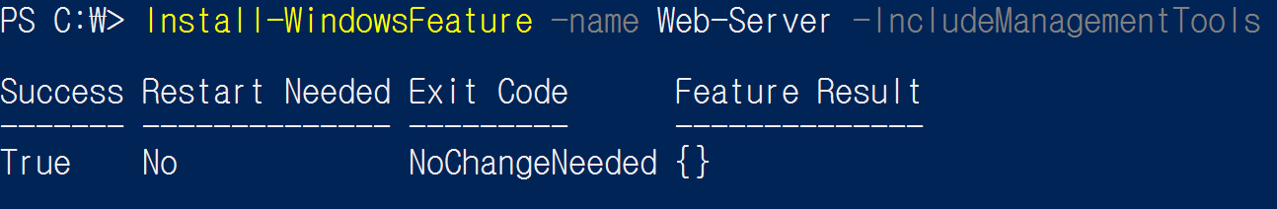
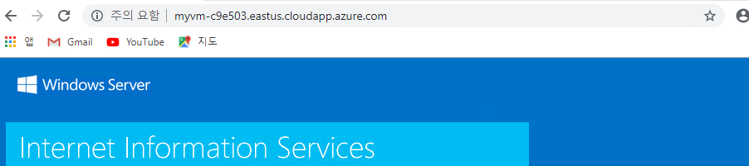
Azure Management Tool Power Shell & Cloud Shell
Power Shell. 02
8. VM의 PowerShell에 Webserver 설치
Notes:
## Import Azure Module
Import-Module Az.Accounts
## Azure Account Connet
Connect-AzAccount
## Sign in Azure
## Subscription ID가 여러개인 경우
Get-AzSubscription ##Subscription Checking
Select-AzSubscription -Subscription <Subscription ID> ## Subscription Sellecting
# Resource Group 만들기
New-AzResourceGroup -Name myResourceGroup -Location EastUS
# New VM 만들기 # `(빽틱) 은 다음 줄로 연결되도록 하는 것
New-AzVm `
-ResourceGroupName "myResourceGroup" `
-Name "myVM" `
-Location "East US" `
-VirtualNetworkName "myVnet" `
-SubnetName "mySubnet" `
-SecurityGroupName "myNetworkSecurityGroup" `
-PublicIpAddressName "myPublicIpAddress" `
-OpenPorts 80,3389
# IpAddress Checking
Get-AzPublicIpAddress -ResourceGroupName "myResourceGroup" | Select "IpAddress"
# VM 접속
mstsc /v 13.92.228.37
# Resource Group 생성할 때 만든 계정으로 로그인
# Webserver install
Install-WindowsFeature -name Web-Server -IncludeManagementTools
# Remove Resource 리소스가 더이상 필요 없을때 제거
Remove-AzResourceGroup -Name myResourceGroup

Slide 13
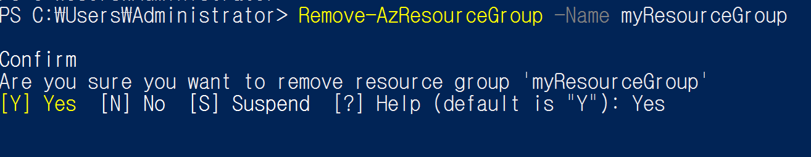
Azure Management Tool Power Shell & Cloud Shell
Power Shell. 02
9. 리소스 삭제
Notes:
## Import Azure Module
Import-Module Az.Accounts
## Azure Account Connet
Connect-AzAccount
## Sign in Azure
## Subscription ID가 여러개인 경우
Get-AzSubscription ##Subscription Checking
Select-AzSubscription -Subscription <Subscription ID> ## Subscription Sellecting
# Resource Group 만들기
New-AzResourceGroup -Name myResourceGroup -Location EastUS
# New VM 만들기 # `(빽틱) 은 다음 줄로 연결되도록 하는 것
New-AzVm `
-ResourceGroupName "myResourceGroup" `
-Name "myVM" `
-Location "East US" `
-VirtualNetworkName "myVnet" `
-SubnetName "mySubnet" `
-SecurityGroupName "myNetworkSecurityGroup" `
-PublicIpAddressName "myPublicIpAddress" `
-OpenPorts 80,3389
# IpAddress Checking
Get-AzPublicIpAddress -ResourceGroupName "myResourceGroup" | Select "IpAddress"
# VM 접속
mstsc /v 13.92.228.37
# Resource Group 생성할 때 만든 계정으로 로그인
# Webserver install
Install-WindowsFeature -name Web-Server -IncludeManagementTools
# Remove Resource 리소스가 더이상 필요 없을때 제거
Remove-AzResourceGroup -Name myResourceGroup

Slide 14
Azure Management Tool Power Shell & Cloud Shell
Power Shell. 02
9. 리소스 삭제
Notes:
## Import Azure Module
Import-Module Az.Accounts
## Azure Account Connet
Connect-AzAccount
## Sign in Azure
## Subscription ID가 여러개인 경우
Get-AzSubscription ##Subscription Checking
Select-AzSubscription -Subscription <Subscription ID> ## Subscription Sellecting
# Resource Group 만들기
New-AzResourceGroup -Name myResourceGroup -Location EastUS
# New VM 만들기 # `(빽틱) 은 다음 줄로 연결되도록 하는 것
New-AzVm `
-ResourceGroupName "myResourceGroup" `
-Name "myVM" `
-Location "East US" `
-VirtualNetworkName "myVnet" `
-SubnetName "mySubnet" `
-SecurityGroupName "myNetworkSecurityGroup" `
-PublicIpAddressName "myPublicIpAddress" `
-OpenPorts 80,3389
# IpAddress Checking
Get-AzPublicIpAddress -ResourceGroupName "myResourceGroup" | Select "IpAddress"
# VM 접속
mstsc /v 13.92.228.37
# Resource Group 생성할 때 만든 계정으로 로그인
# Webserver install
Install-WindowsFeature -name Web-Server -IncludeManagementTools
# Remove Resource 리소스가 더이상 필요 없을때 제거
Remove-AzResourceGroup -Name myResourceGroup

Slide 15
Azure Management Tool
Power Shell & Cloud Shell
Basic Concept
01
Power Shell
02
Cloud Shell
03
Cloud Shell
03
Cloud Shell
03
Question
04

Slide 16
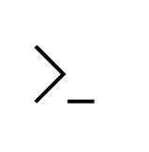
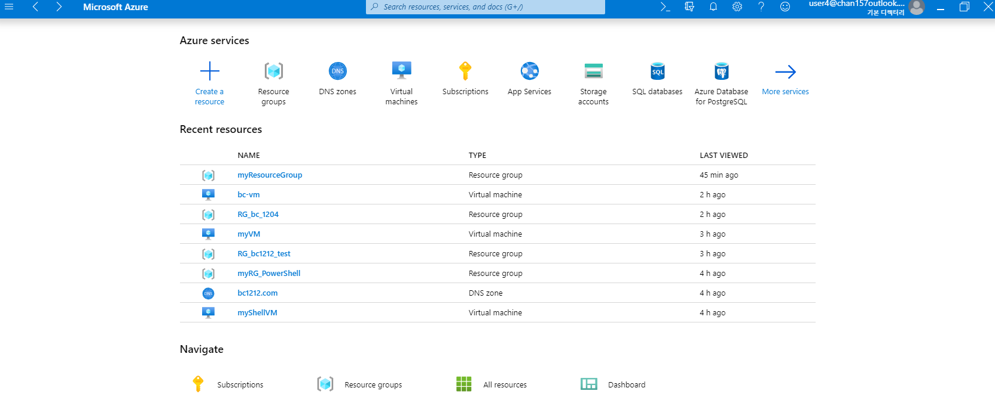
Azure Management Tool Power Shell & Cloud Shell
Cloud Shell. 03
1. Azure Portal – Cloud Shell 환경 설정
Notes:
ㅍ

Slide 17
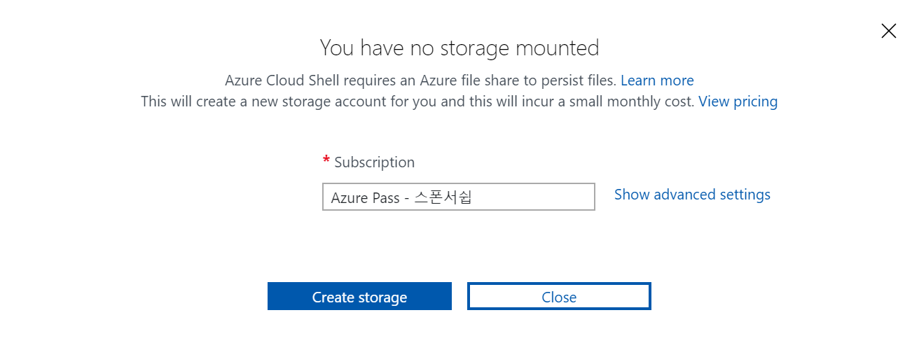
Azure Management Tool Power Shell & Cloud Shell
Cloud Shell. 03
1. Azure Portal – Cloud Shell 환경 설정
Notes:
ㅍ

Slide 18
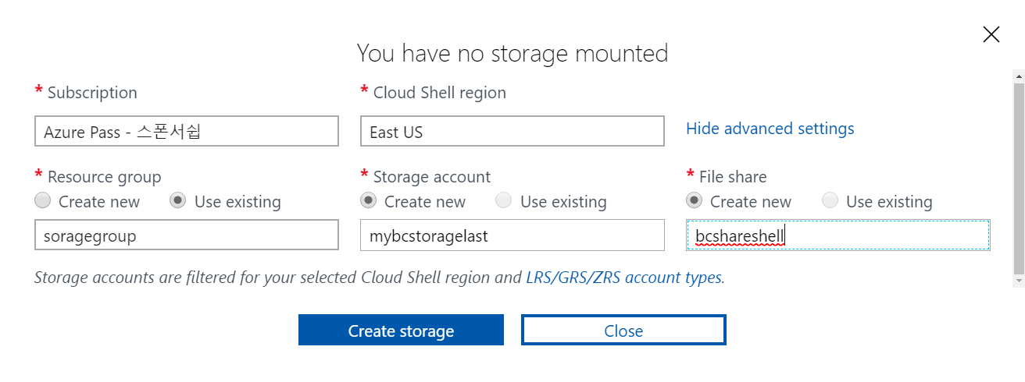
Azure Management Tool Power Shell & Cloud Shell
Cloud Shell. 03
1. Azure Portal – Cloud Shell 환경 설정
Notes:
ㅍ

Slide 19
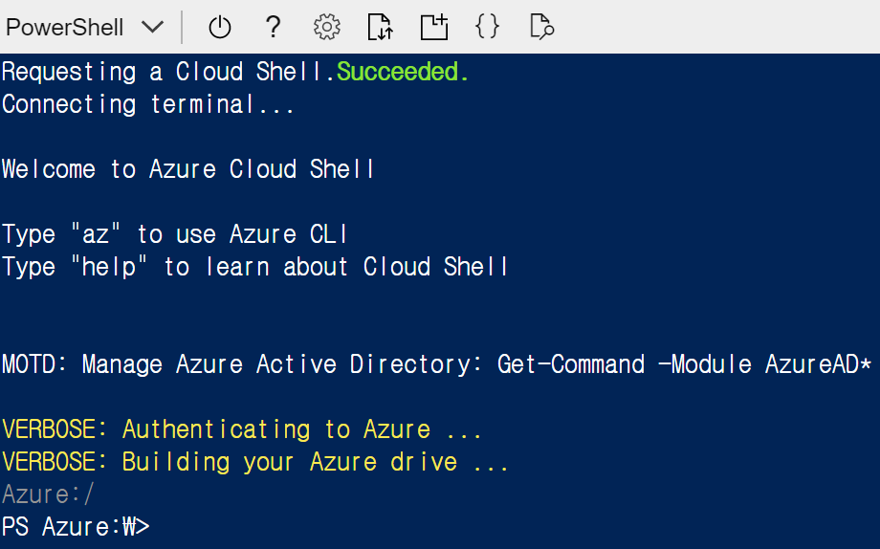
Azure Management Tool Power Shell & Cloud Shell
Cloud Shell. 03
2. Azure Portal – Cloud Shell – Power Shell
Notes:
ㅍ

Slide 20
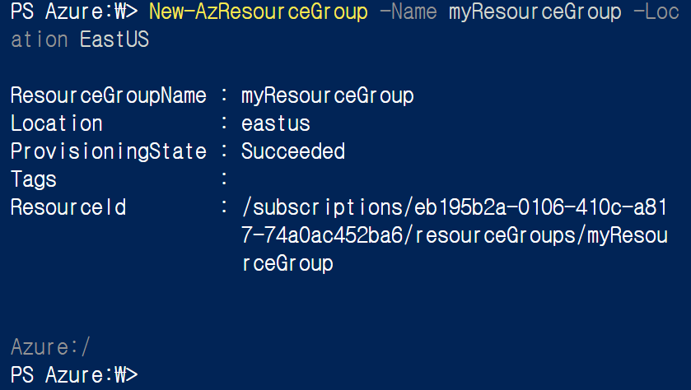
Azure Management Tool Power Shell & Cloud Shell
Cloud Shell. 03
3. Azure Portal – Cloud Shell – 리소스 생성
Notes:
## Import Azure Module
Import-Module Az.Accounts
## Azure Account Connet
Connect-AzAccount
## Sign in Azure
## Subscription ID가 여러개인 경우
Get-AzSubscription ##Subscription Checking
Select-AzSubscription -Subscription <Subscription ID> ## Subscription Sellecting
# Resource Group 만들기
New-AzResourceGroup -Name myResourceGroup -Location EastUS

Slide 21
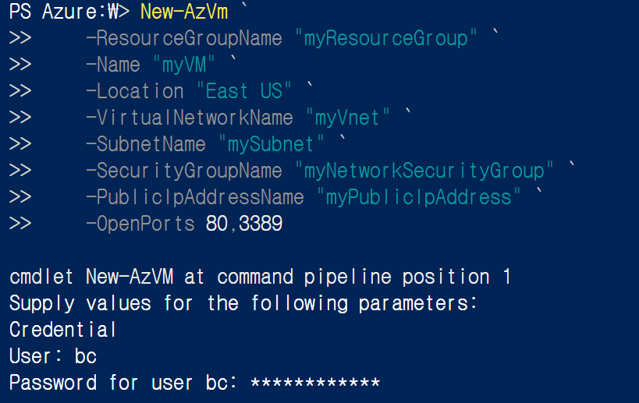
Azure Management Tool Power Shell & Cloud Shell
Cloud Shell. 03
4. Azure Portal – Cloud Shell – VM 생성
Notes:
ㅍ

Slide 22
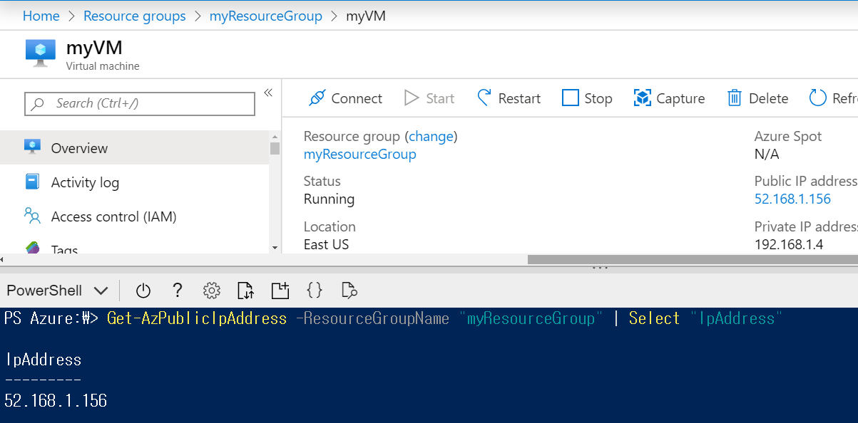
Azure Management Tool Power Shell & Cloud Shell
Cloud Shell. 03
4. Azure Portal – Cloud Shell – VM 생성 결과
Notes:
ㅍ

Slide 23
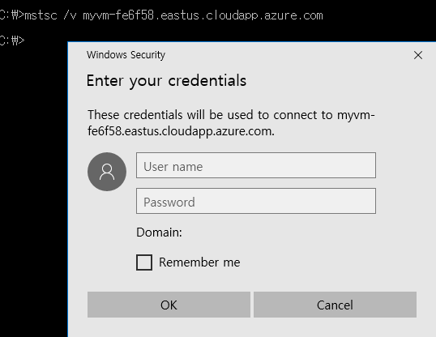
Azure Management Tool Power Shell & Cloud Shell
Cloud Shell. 03
5. Azure Portal – Cloud Shell – VM 원격 접속
Notes:
ㅍ

Slide 24
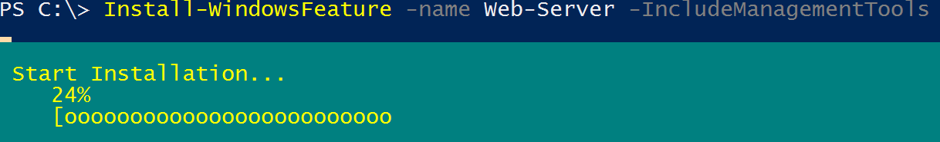
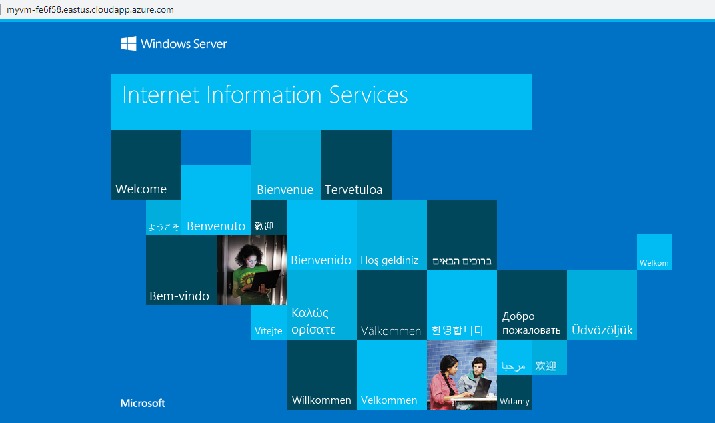
Azure Management Tool Power Shell & Cloud Shell
Cloud Shell. 03
6. Azure Portal – Cloud Shell – WebServer 설치 및 결과
Notes:
# Webserver install
Install-WindowsFeature -name Web-Server -IncludeManagementTools
# Remove Resource 리소스가 더이상 필요 없을때 제거
Remove-AzResourceGroup -Name myResourceGroup

Slide 25
Azure Management Tool
Power Shell & Cloud Shell
Basic Concept
01
Power Shell
02
Cloud Shell
03
Question
04
Question
04
Question
04

Slide 26

Azure Management Tool Power Shell & Cloud Shell
Question. 04
Any Question ?
Presentation from 박 찬
Mail Address : chan157@naver.com
GitHub Address : https://github.com/chan157/TIL/
Phone Number : 010-4484-1251
Reference
MS learn Website : https://docs.microsoft.com/ko-kr/powershell/azure/get-started-azureps?view=azps-3.1.0
GitHub-Module2 : https://github.com/chan157/10979-Introduction-to-Azure-for-IT-Professionals/blob/master/Instructions/10979F_LAB_02.md
GitHub-AzurePowerShell : https://github.com/Azure/azure-powershell/blob/master/documentation/azure-powershell-modules.md
Notes:
# Webserver install
Install-WindowsFeature -name Web-Server -IncludeManagementTools
# Remove Resource 리소스가 더이상 필요 없을때 제거
Remove-AzResourceGroup -Name myResourceGroup

